Slide 1
Applied Data Science Capstone
Tony Hsu
3 March 2022
Source: https://github.com/lichkeam/Applied-Data-Science-Capstone

Slide 2
Outline
Executive Summary
Introduction
Methodology
Results
Conclusion
Appendix

Slide 3
Executive Summary
Data Collection
Data was collected from public Space X API and request module from Python. Besides, Space X Wikipedia page also provides data in this project.
Data analysis(EDA)
We perform some explored data analysis and statistical results using SQL that gathered relevant columns to seen as features.
All the categorical variables are transformed to one hot encoding.
Visualization
We use folium maps and some dashboard to present our analysis result
Modeling and Predictive Performance
For data preprocessing, we standardize the raw data for the purpose of seeking higher fitting quality.
We use the follow popular models: Logistic Reg, SVM, Decision Tree and KNN.
For tuning parameters, we use GridSearchCV module to find the best parameters for machine learning models.

Slide 4
Introduction
Background
We acted as an data science from Space Y to search some commercial potential from the data provided by Space X.
Space X (Falcon 9) has best pricing (62 million USD to upward 165 million USD)
Largely due to ability to recover part of rocket(Stage 1).
It is expected to stand for a compatible company to Space X from Space Y.
Challenge
We are asked to:
Determine the price of each launch.
Gather public information about Space X and create dashboards for the team.
Try to discover a machine learning model to predict successful Stage 1 recovery.

Slide 5
Methodology
Overview of Data collection, web scrapping, wrangling, dashboard, and modeling techniques

Slide 6
Methodology
Data collection methodology
Combined data from Space X API and Space X Wiki page.
Data wrangling
Classify true landing if it success, unsuccessful otherwise.
Exploratory data analysis
Using SQL to compute some statistical result.
Visualization using matplotlib.
Interactive analytic tools using Folium and Ploty (Dash)
Construct classification models
Use GridSearchCV to tune parameters in models

Slide 7
Data Collection Overview
Data collection process involved a combination of API request from Space X public API and web scrapping from a table in Space X’s wiki entry.
We will present the flowchart of processing the data from Space X API and web scrapping.

Slide 8
Data Collection – Space X API
https://github.com/lichkeam/Applied-Data-Science-Capstone/blob/main/Spacex%20data%20collection%20api.ipynb
User Terminal
Space X API
Backend Server
4.Convert .json to pandas DataFrame to do further analysis
Use request module to
ask for the reply
2. Request confirm send back the information.
3. Send back the data using JSON file

Slide 9
Data Collection– Web Scraping
https://github.com/lichkeam/Applied-Data-Science-Capstone/blob/main/Spacex%20Webscraping.ipynb
User Terminal
Wiki html API
Backend Server
4.Convert request object to pandas DataFrame and dictionary to do further analysis
Use BeautifulSoup module to parse html5lib
2. Find launch info html table
3. Send back the data by request object

Slide 10
Data Wrangling
https://github.com/lichkeam/Applied-Data-Science-Capstone/blob/main/Data%20wrangling.ipynb
Create a training label with landing outcome( successful = 1, 0 for others)
Outcome column has two components, 1.Mission Outcome 2.Landing Location
‘class’ column turns out to 1 if ‘Mission Outcome’ is True, otherwise 0.
Columns name transform and fix
True ASDS, RTLS, Ocean set to 1
None, False ASDS, Ocean, RTLS set to 0

Slide 11
EDA with Data Visualization
https://github.com/lichkeam/Applied-Data-Science-Capstone/blob/main/EDA%20with%20python.ipynb
Here we perform variables
Flight number, Payload mass, Launch site, Orbit, Class and Year.
Plots show out
Scatter plots
Line charts
Bar plots
Variables visualization
Flight Number v.s. Payload Mass
Flight Number v.s. Launch Site
Payload Mass v.s. Launch Site
Orbit v.s. Success Rate
Success Yearly Trend

Slide 12
EDA with SQL
https://github.com/lichkeam/Applied-Data-Science-Capstone/blob/main/EDA%20with%20sql.ipynb
Load data to database
Queried using SQL Python integration
Queries were expected to get a better understanding dataset.
Queried information about the following features
Site names
Mission outcomes
Various pay load sizes of customers
Booster version
Landing outcomes

Slide 13
Build an interactive map with Folium
https://github.com/lichkeam/Applied-Data-Science-Capstone/blob/main/Launch%20site%20location%20with%20folium.ipynb
Launch Sites Location Analysis with Folium
Folium maps mark out the Launch Sites, landings, and some example key location such as Railway, Highway, Coast, and City.
We may have some idea to figure out the relationship between launch sites and location.

Slide 14
Predictive analysis (Classification)
https://github.com/lichkeam/Applied-Data-Science-Capstone/blob/main/Machine%20Learning%20Prediction.ipynb
Pre-processing
Standardize numeric features
Split data to Training and test set
Modeling and tuning
Consider those models, LogReg, SVM, DT, KNN
Tuning with GridSearchCV
Evaluation
Confusion matrix
Using bar plot to show the score of models

Slide 15
RESULTS

Slide 16
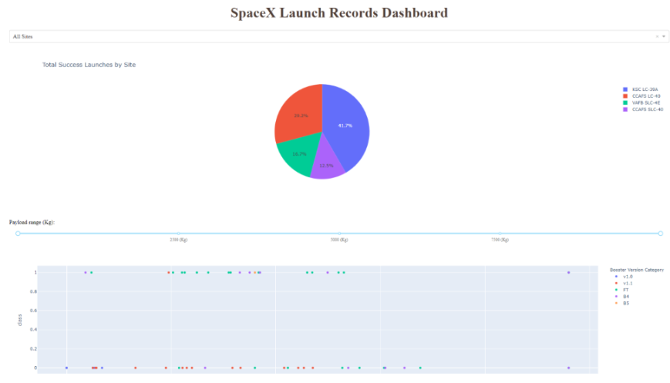
Overview the results
This is a preview of the Plotly dashboard. The following slides will show the results of EDA with
visualization, EDA with SQL, Interactive Map with Folium, and finally the results of our model with
about 83% accuracy

Slide 17
EDA with Visualization

Slide 18
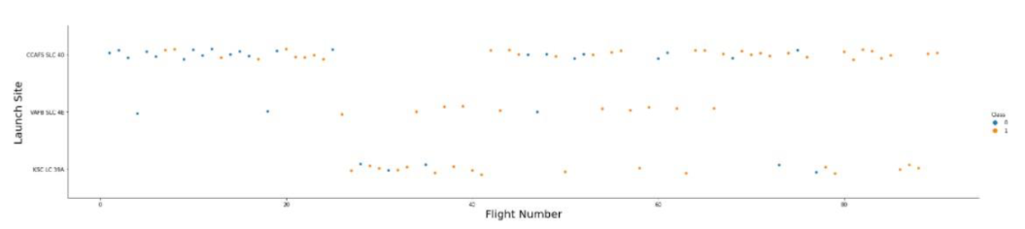
Flight Number vs. LaunchSite
Orange indicates successful launch
Blue indicates unsuccessful launch
Graphic suggests an increase in success rate over time (indicated in Flight Number).
Likely a big breakthrough around flight 20 which significantly increased success rate.
CCAFS appearsto be the main launch site as it has the most volume.

Slide 19
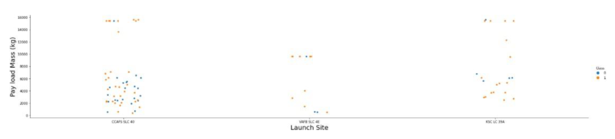
Payload vs. Launch Site
Orange indicates successful launch
Blue indicates unsuccessful launch
Payload mass appears to fall mostly between 0-7000 kg.
Different launch sites also seem to use different payload mass

Slide 20
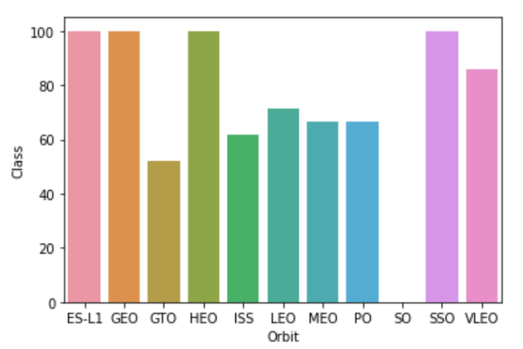
Success rate vs. Orbit type
rate
ES-L1 (1), GEO (1), HEO (1) have 100% success rate (sample sizes in parenthesis)
SSO (5) has 100%success rate
VLEO (14) has decent success rate and attempts
SO (1) has 0% success rate
GTO (27) has the around 50% success rate but largest sample

Slide 21
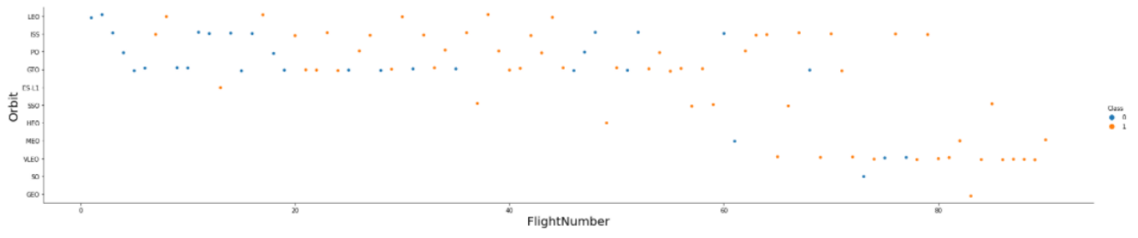
Flight Number vs. Orbit type
Orange indicates successful launch
Blue indicates unsuccessful launch
Launch Orbit preferences changed over FlightNumber.
Launch Outcome seems to correlatewith this preference.
SpaceX started with LEO orbits which saw moderate success LEO and returned to VLEO in recent launches
SpaceX appearsto performbetterin lower orbits or Sun-synchronousorbits

Slide 22
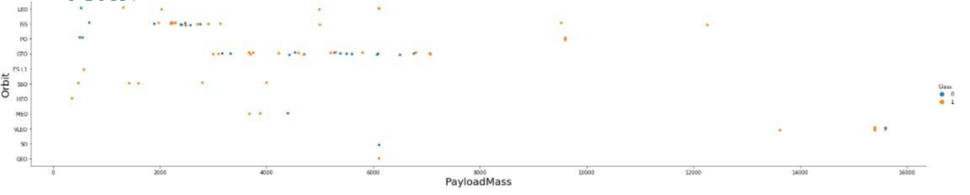
Payload vs. Orbit type
Orange indicates successful launch
Blue indicates unsuccessful launch
Payloadmassseems to correlatewith orbit
LEOand SSO seem to haverelatively lowpayload mass
The other mostsuccessful orbit VLEO only has payloadmass valuesin the higher end of the range

Slide 23
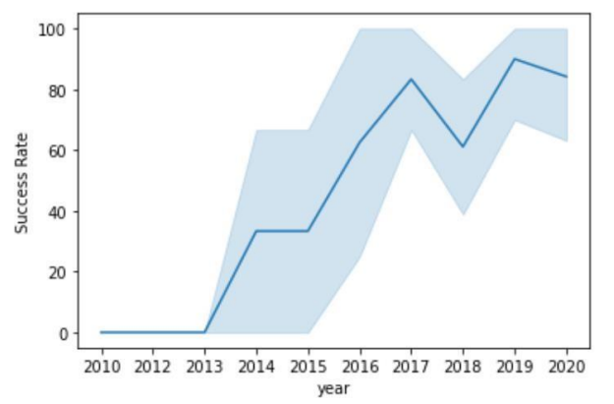
Launch Success Yearly Trend
95%confidence interval
Success generally increases over time since 2013 with a slight dip in 2018
Success in recent years at around 80%

Slide 24
EDA with SQL
Exploratory
Data analysis
SQL table integrated

Slide 25
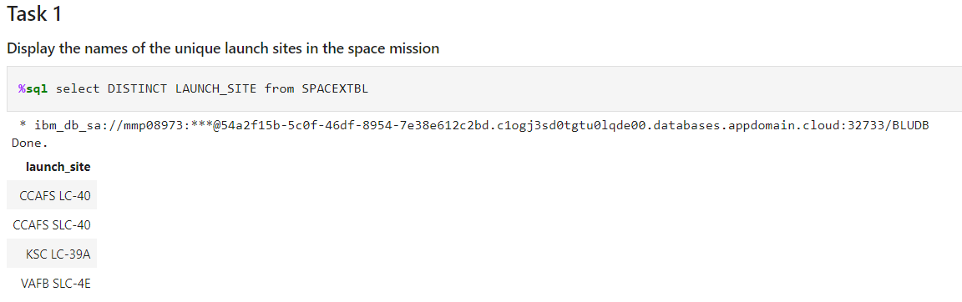
All Launch Site Names

Slide 26
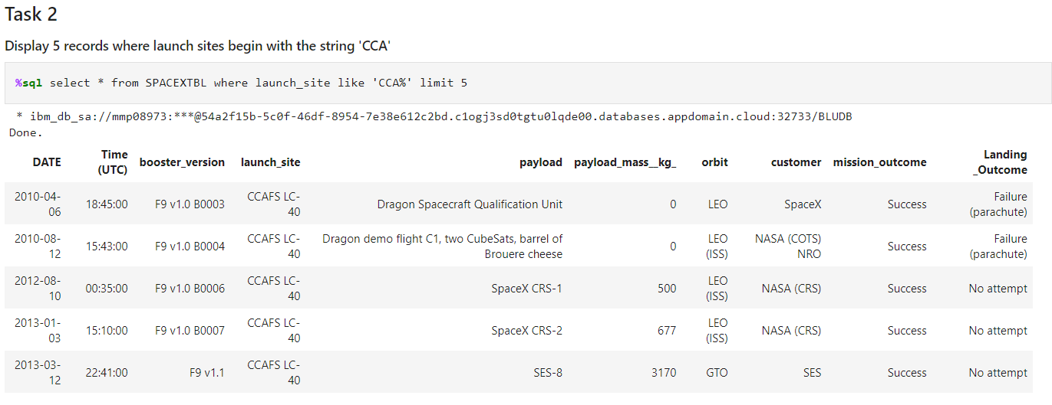
Launch Site Names Beginning with `CCA`
First five entries in database with Launch Site name beginning with CCA.

Slide 27
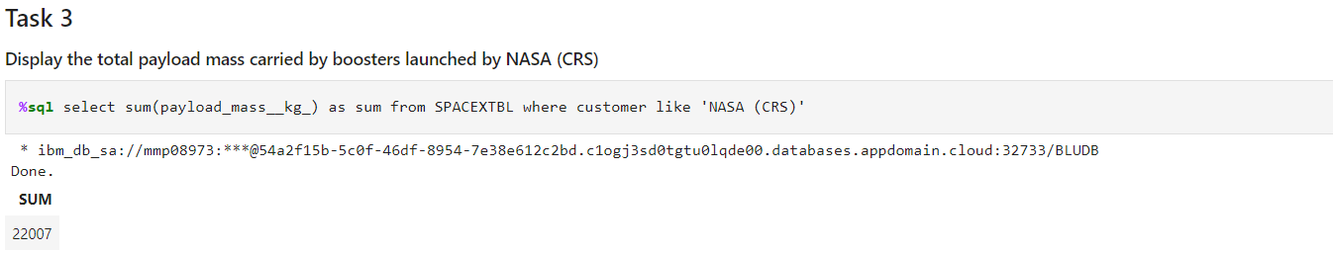
Total Payload Mass from NASA
1. This query sums the total payload mass in kg where NASA was the customer.
2. CRS stands for Commercial Resupply Services which indicates that these payloads were sent to the International Space Station (ISS).

Slide 28
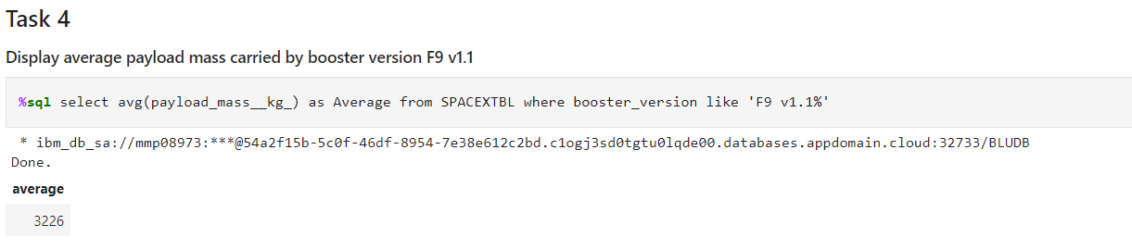
Average PayloadMassby F9 v1.1
This query calculates the average payload mass or launches which used booster version F9 v1.1
Average payload mass of F9 1.1 is on the low end of our payload mass range

Slide 29
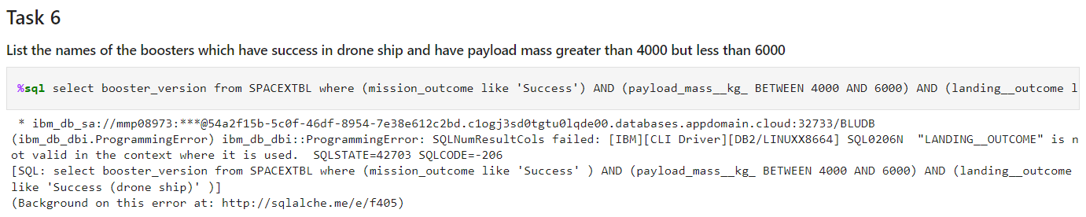
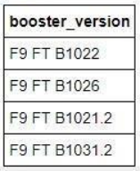
Successful Drone Ship Landing with Payload Between 4000 and 6000
This query returns the four booster versions that had successful drone ship landings and a payload mass between 4000 and 6000noninclusively.

Slide 30
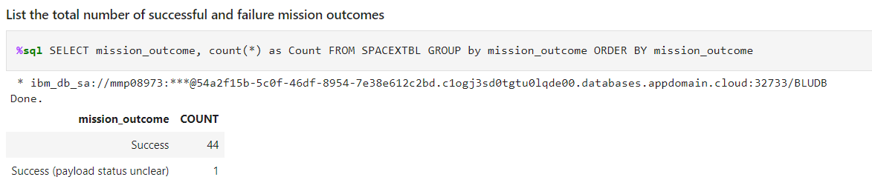
Total Number of Each Mission Outcome
1. This query returns a count of each mission outcome.
2. SpaceX appears to achieve its mission outcome nearly 99% of the time.
3. This means that most of the landing failures are intended.
4. Interestingly, one launch has an unclear payload status and unfortunately one failed in flight.

Slide 31
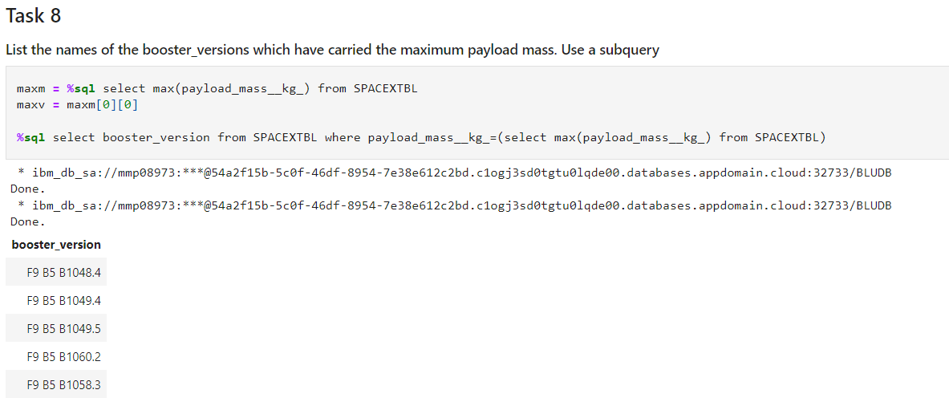
Boosters that Carried Maximum Payload
1. This query returns the booster versions that
carried the highest payload mass of 15600 kg.
2. These booster versions are very similar and
all are of the F9 B5 B10xx.x variety.
3. This likely indicates payload mass correlates
with the booster version that is used.

Slide 32
Interactive Map with Folium

Slide 33
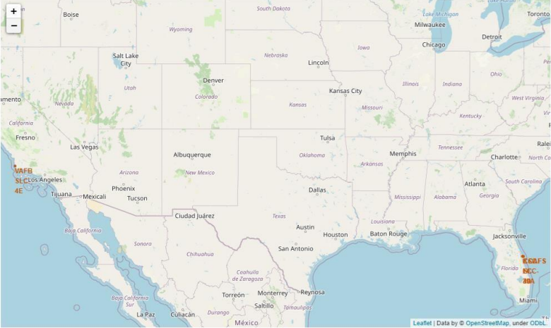
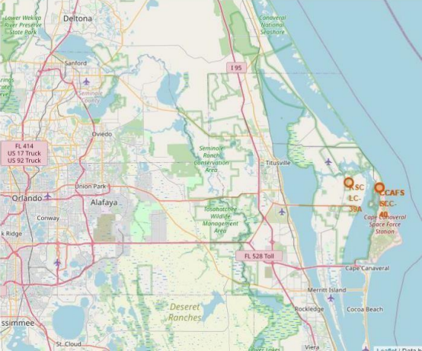
Launch Site Locations
The left map shows all launch sites relative US map. The right map shows the two Florida launch sites since they are very close to each others. All launch sites are near the ocean.

Slide 34
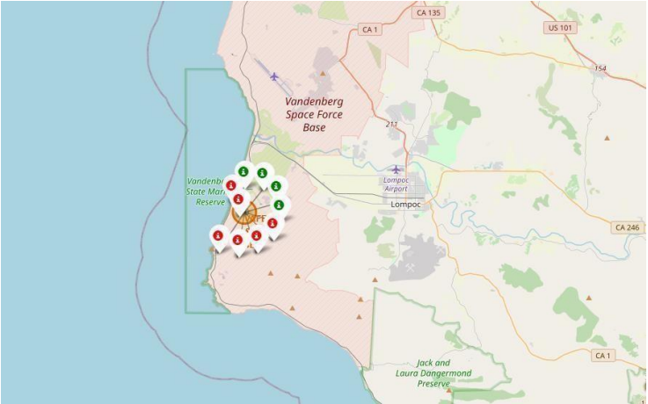
Color-Coded Launch Markers
Clusters on Folium map can be clicked on to display each successful landing (green icon) and failed
landing (red icon). In this example VAFB SLC-4E shows 4 successful landings and 6 failed landings.

Slide 35
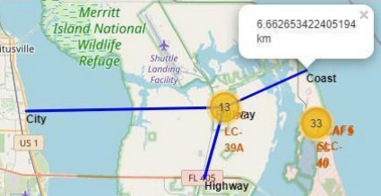
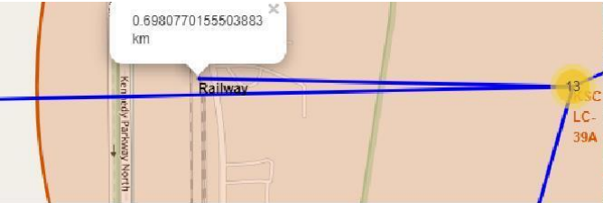
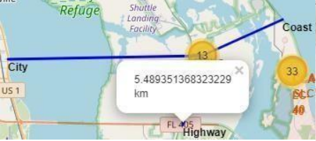
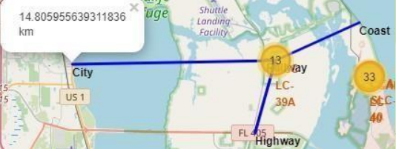
Key Location Proximities
Using KSC LC-39A as an example, launch sites are very close to railways for large part and supply transportation. Launch sites are close to highways for human and supply transport. Launch sites are also close to coasts and relatively far from cities so that launch failures can land in the sea to avoid rockets falling on densely populated areas.

Slide 36
Build a Dashboard with Plotly Dash

Slide 37
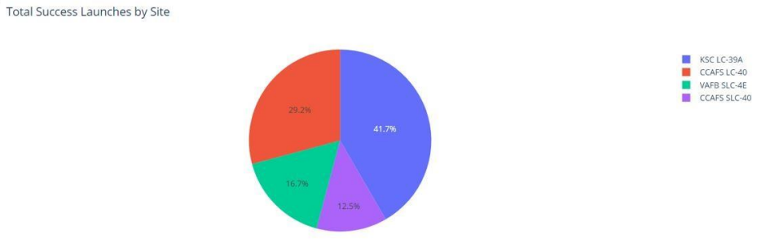
Successful Launches Across Launch Sites
This is the distribution of successful landings across all launch sites. CCAFS LC-40 is the old name of CCAFS SLC-40 so CCAFS and KSC have the same amount of successful landings, but a majority of the successful landings where performed before the name change. VAFB has the smallest share of successful landings. This maybe due to smaller sample and increase in difficulty of launching in the west coast.

Slide 38
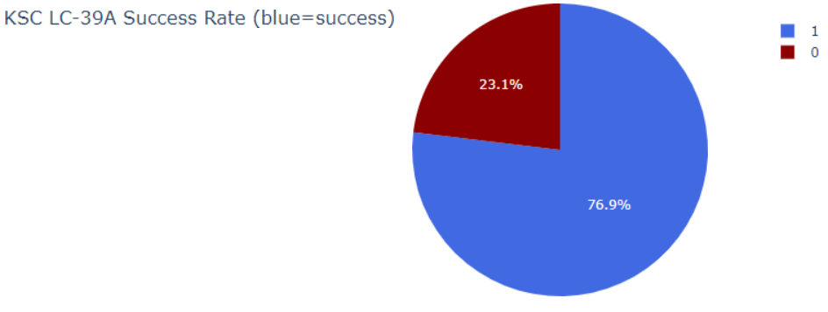
Highest Success Rate Launch Site
KSC LC-39A has the highest success rate with 10 successful landings and 3 failed landings

Slide 39
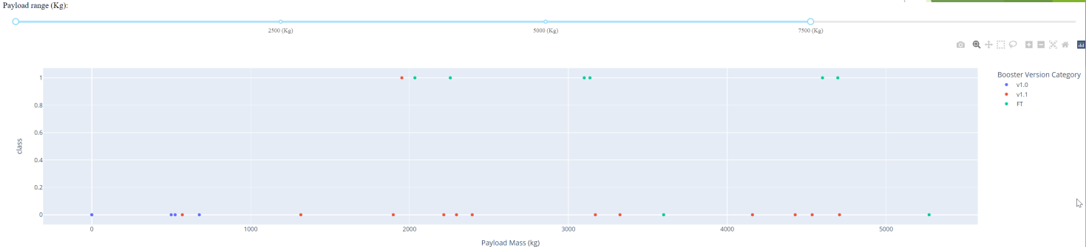
Payload Mass vs. Success vs. Booster Version Category
Plotly dashboard has a Payload range selector. However, this is set from 0-10000 instead of the max Payload of 15600. Class indicates 1 for successful landing and 0 for failure. Scatter plot also accounts for booster version category in color and number of launches in point size. In this particular range of 0-7500, interestingly, there are two failed landings with payloads of zero kg.

Slide 40
Classification predictive analysis
Logistic Regression
SVM
Decision Tree
KNN

Slide 41
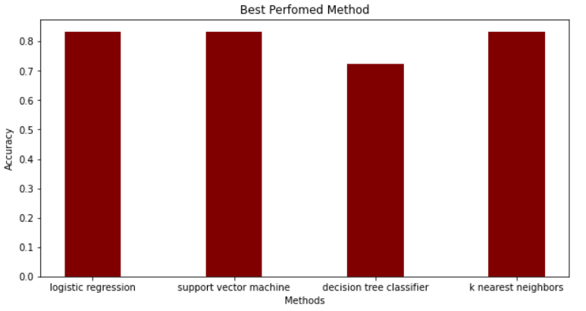
Classification Accuracy
The models above indicates similar accuracy around 83%, except decision tree classifer with 72%
Note that the test samples only contains n = 18
It does not provide too much confidential to the results since small sample tends to cause large variance.

Slide 42
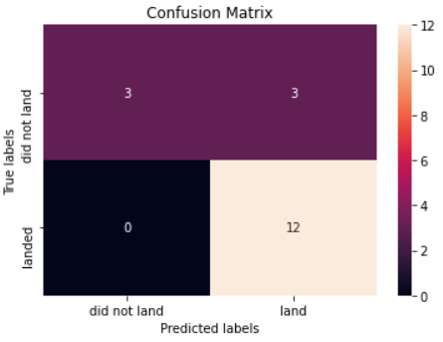
Confusion matrix discussion
All the model predicted same results in the confusion matrix, we only show it once.
15 of the test samples were predicted correctly( 12 successful, 3 failed)
3 of the test samples predicted landing successful but failed actually.

Slide 43
Conclusion
We develop some models which has about 83% accuracy and 100% precision for prediction
of landing failure, in other words, if the rocket predicted to be failed landing, it has a hundred
percent come true
Allon Mask, CEO of space Y can apply these models before launching the model. For some example,
if the models told us that the landing result is failed. Since the model currently indicate a high precision
on predicting fail landing, CEO should decide NOT TO launch in that situation.
As a recommendation, it’s better to add more sample to train the models since it show a high variation
over the cross-validation.

Slide 44
Appendix
GitHub repository:
https://github.com/lichkeam/Applied-Data-Science-Capstone
Instructor from IBM Coursera source
https://www.coursera.org/learn/applied-data-science-capstone/home/info
Wikipedia
https://en.wikipedia.org/wiki/SpaceX

